Slide 1
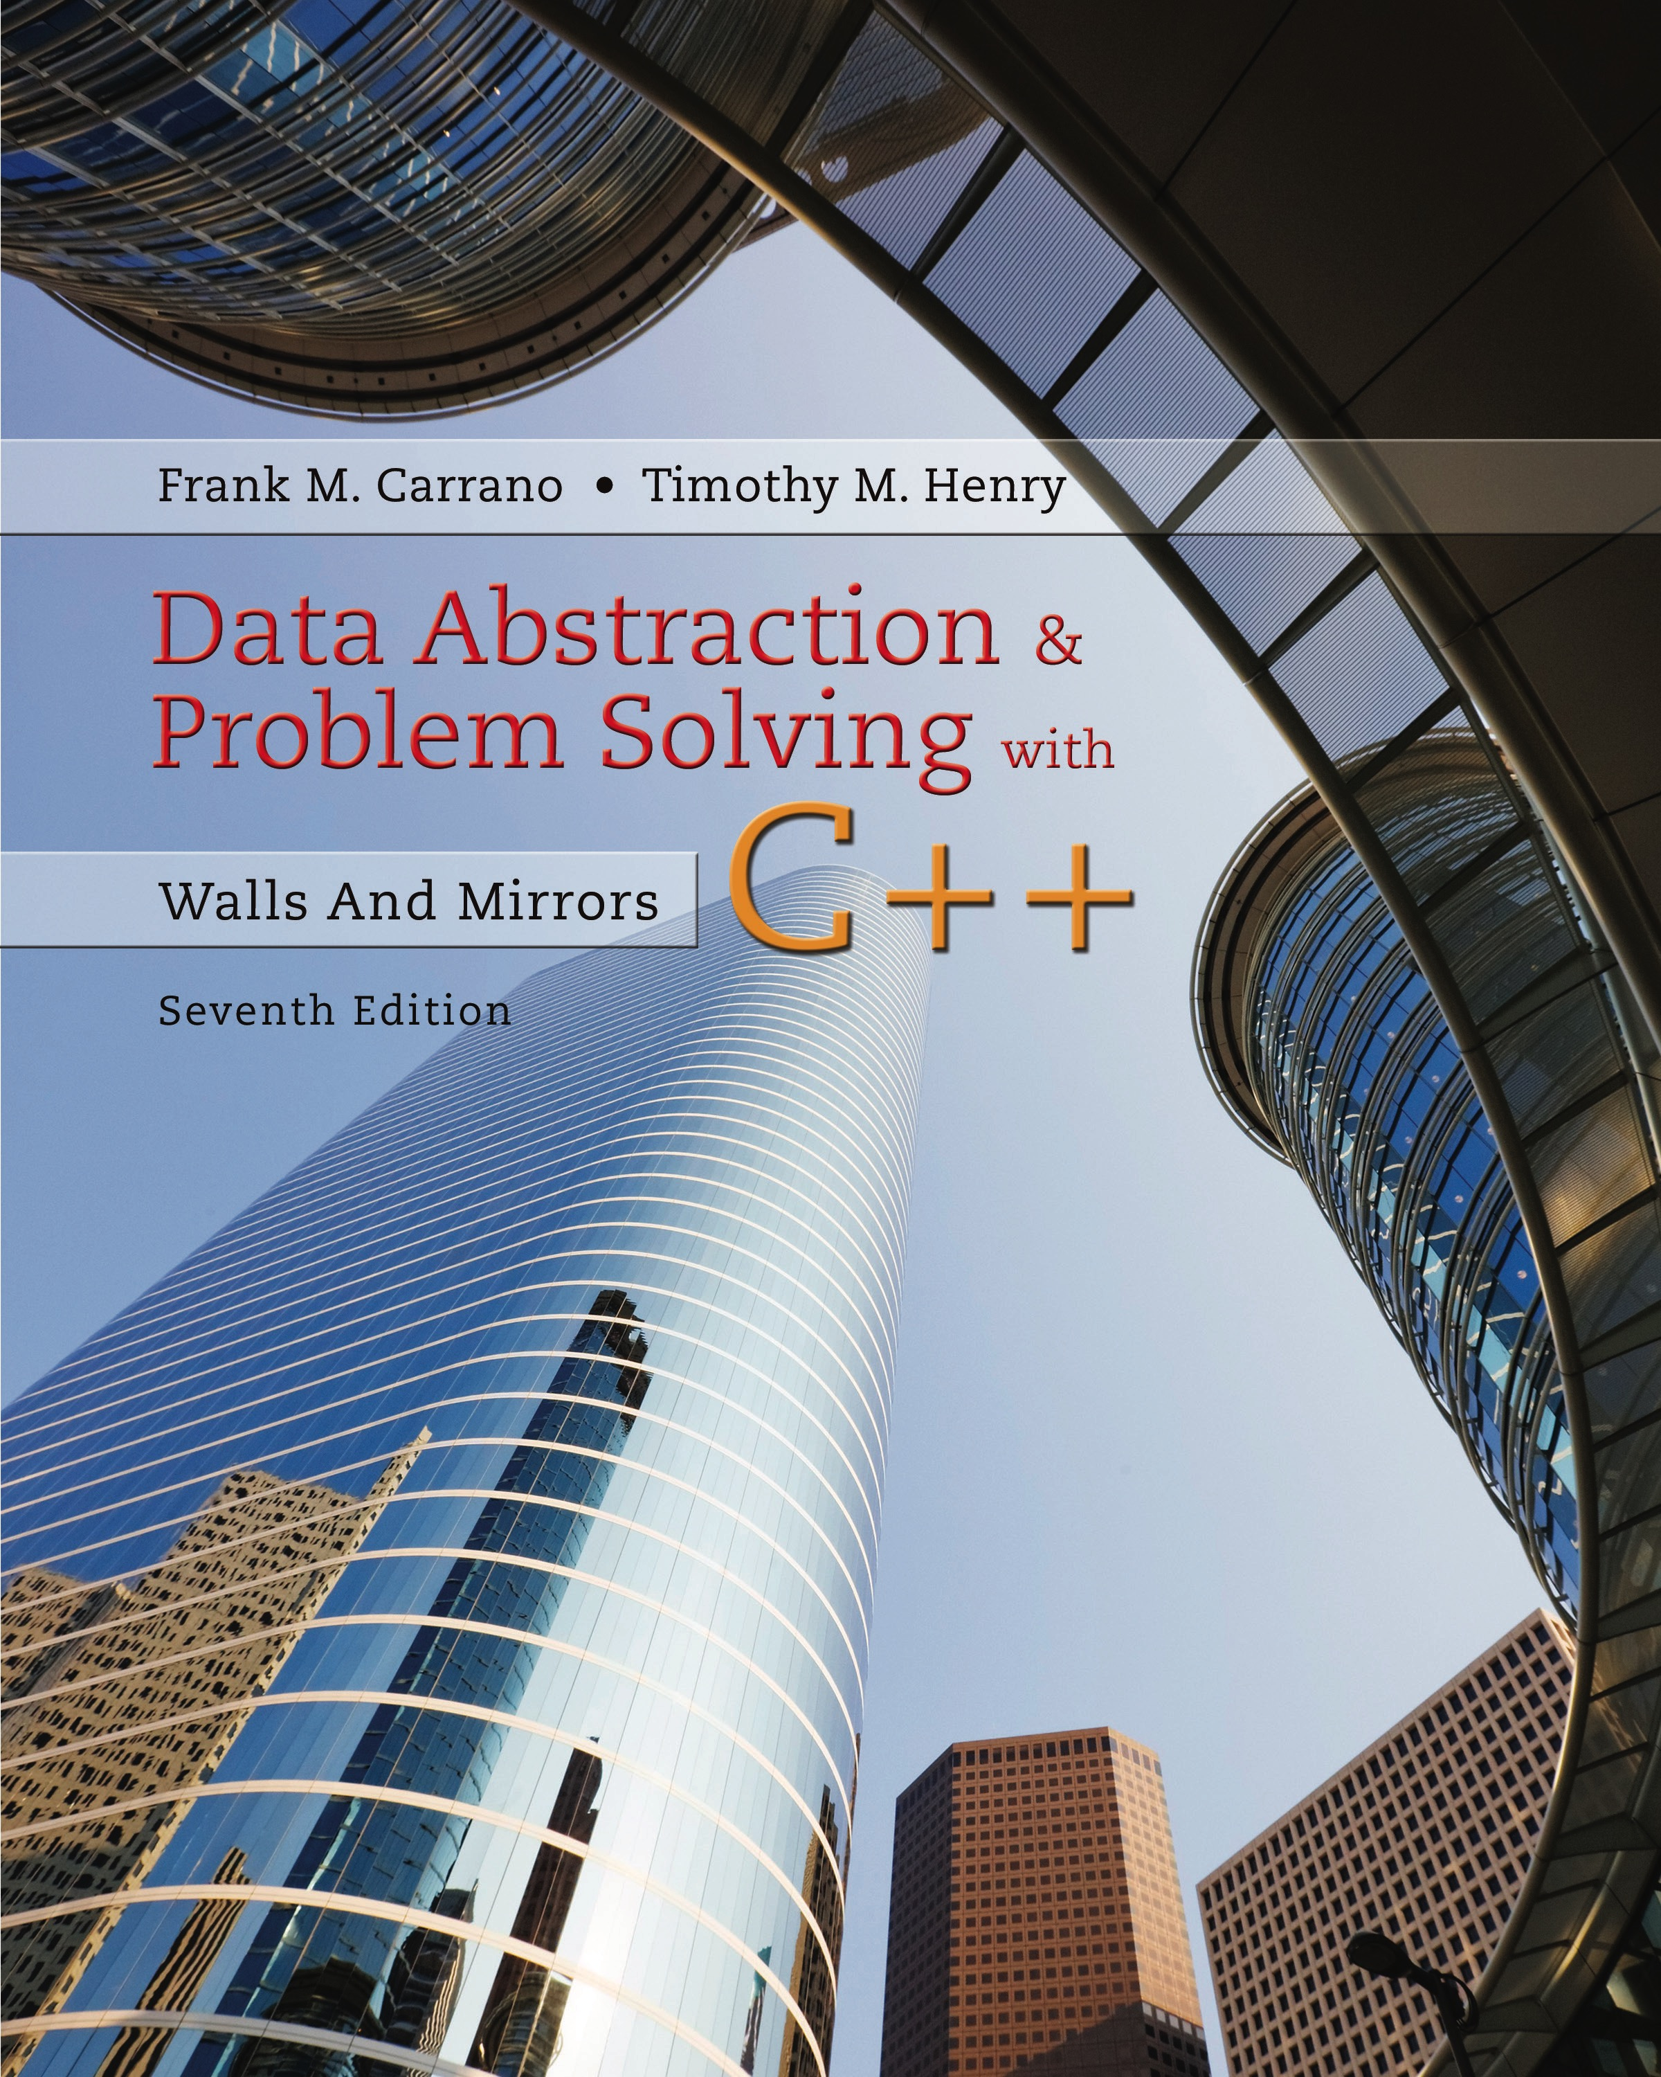
Data Abstraction & Problem Solving with C++: Walls and Mirrors
Seventh Edition
C++ Interlude 8
The Standard Template Library
Copyright © 2017, 2013, 2007 Pearson Education, Inc. All Rights Reserved
Notes:
If this PowerPoint presentation contains mathematical equations, you may need to check that your computer has the following installed:
1) MathType Plugin
2) Math Player (free versions available)
3) NVDA Reader (free versions available)

Slide 2
S T L Containers (1 of 6)
C++ has a library of container classes
In form of class templates
Defined as Standard Template Library (S T L)
So why does this text develop A D Ts?
Learn how to develop A D Ts not found in S T L
S T L not part of class hierarchy
Working in a language without S T L

Slide 3
S T L Containers (2 of 6)
Types of containers using S T L
Container adapters
Sequence containers
Associative containers
Operations common to all S T L containers
Constructor, destructor
operator =
bool empty()
unit size()

Slide 4
S T L Containers (3 of 6)
S T L stack operations
value_type& top()
void push(value_type& item)
void pop()
S T L queue operations
value_type& front()
value_type& back()
void push(value_type& item)
void pop()

Slide 5
S T L Containers (4 of 6)
S T L priority_queue operations
value_type& top()
void push(value_type& item)
void pop()

Slide 6
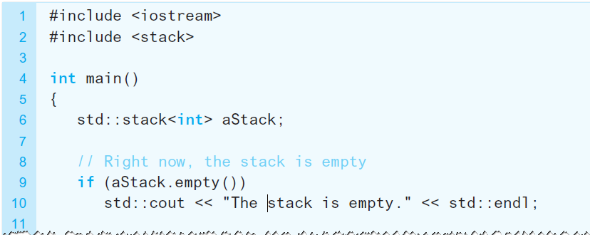
S T L Containers (5 of 6)
Listing C8-1 Example use of the S T L stack

Slide 7
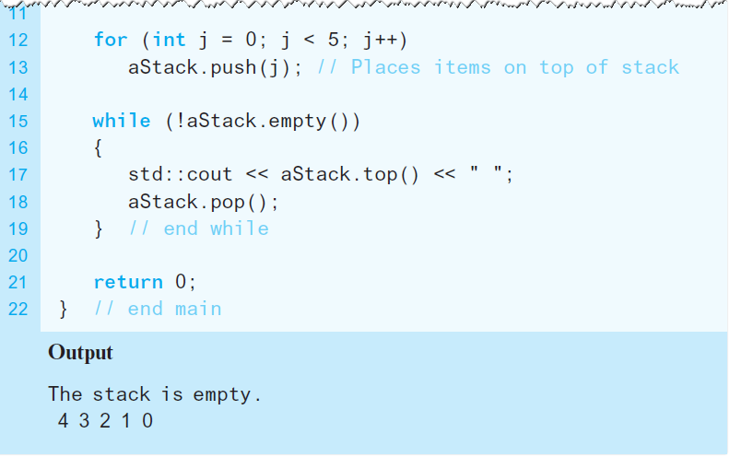
S T L Containers (6 of 6)
Listing C8-1 (continued)

Slide 8
Sequence Containers (1 of 8)
S T L array Operations
value_type& front()
value_type& back()
value_type& at(size_type n)
void fill(const value_type& val)
iterator begin()
iterator end()
reverse_iterator rbegin()
reverse_iterator rend()

Slide 9
Sequence Containers (2 of 8)
Operations common to S T L sequence containers
value_type& front()
value_type& back()
void push_back(value_type& item)
void pop_back(value_type& item)
void resize(uint newSize)
void clear()`

Slide 10
Sequence Containers (3 of 8)
void insert(uint position,
value_type& item)
void insert(iterator itPosition,
value_type& item)
void erase(uint position)
void erase(iterator itPosition)

Slide 11
Sequence Containers (4 of 8)
iterator begin()
iterator end()
reverse_iterator rbegin()
reverse_iterator rend()

Slide 12
Sequence Containers (5 of 8)
Additional S T L vector Operation
value_type& at(size_type n)
Additional S T L deque Operations
value_type& at(size_type n)
void push_front(value_type& item)
void pop_front(value_type& item)

Slide 13
Sequence Containers (6 of 8)
Additional S T L list and forward_list Operations
void push_front(value_type& item)
void pop_front(value_type& item)
void remove(value_type& val)
void sort()
void merge(list<value_type>& rhs)
void slice(iterator position, list<value_type>& rhs)
void reverse()

Slide 14
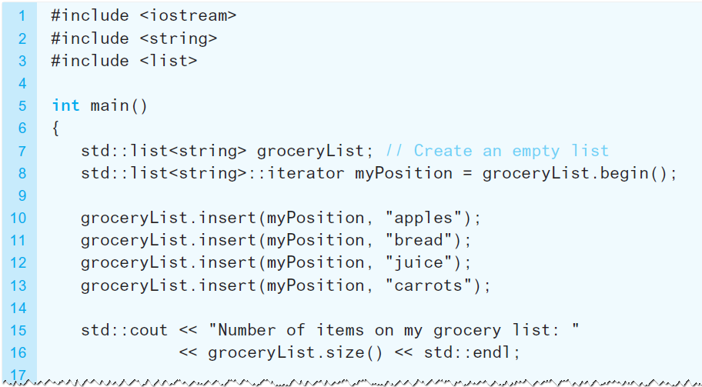
Sequence Containers (7 of 8)
Listing C8-2 Example of using the S T L list

Slide 15
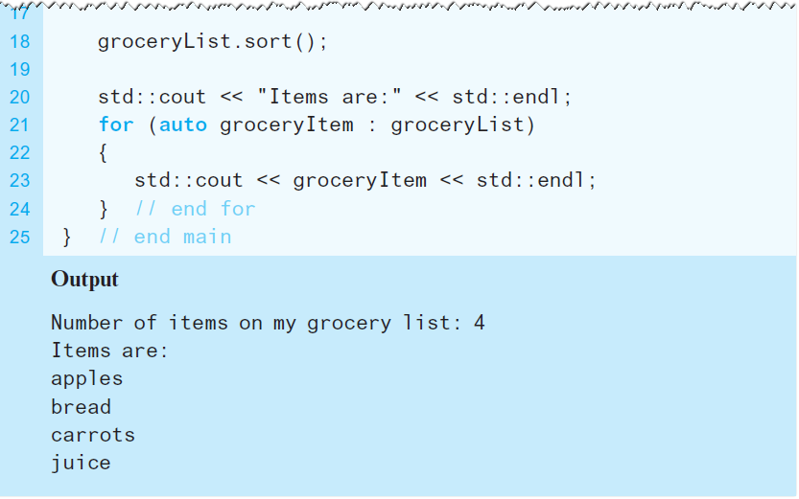
Sequence Containers (8 of 8)
Listing C8-2 [Continued]

Slide 16
Associative Containers (1 of 6)
Operations Common to the S T L set and multiset
void clear()
void insert(value_type& item)
void erase(value_type& item)
void erase(iterator& position)
iterator find(value_type& item)
uint count(value_type& item)

Slide 17
Associative Containers (2 of 6)
iterator lower_bound(value_type& item)
iterator upper_bound(value_type& item)
iterator begin()
iterator end()
reverse_iterator rbegin()
reverse_iterator rend()

Slide 18
Associative Containers (3 of 6)
Operations Common to the S T L map and multimap
void clear()
void insert(pair_type& item)
uint erase(key_type& item)
void erase(iterator& position)
iterator find(key_type& item)
uint count(key_type& item)

Slide 19
Associative Containers (4 of 6)
iterator lower_bound(key_type& item)
iterator upper_bound(key_type& item)
iterator begin()
iterator end()
reverse_iterator rbegin()
reverse_iterator rend()

Slide 20
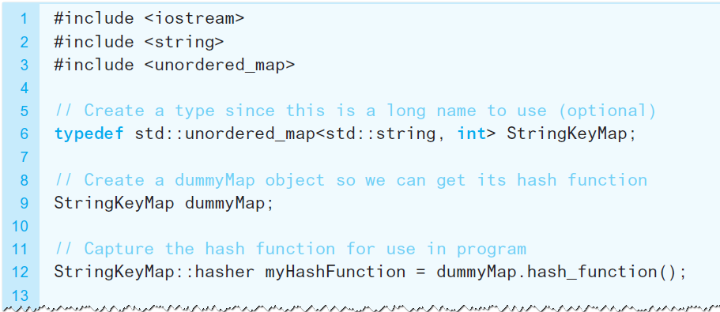
Associative Containers (5 of 6)
Listing C8-3 Alternative definition of a hashing function

Slide 21
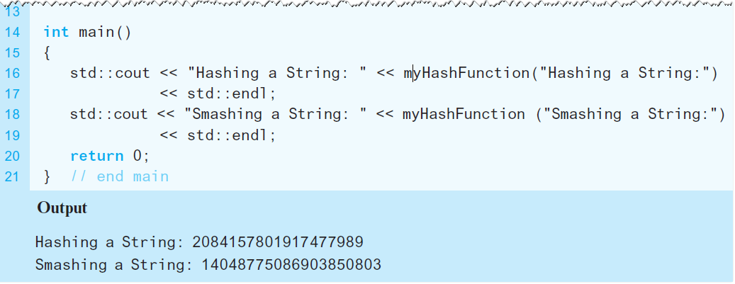
Associative Containers (6 of 6)
Listing C8-3 [Continued]

Slide 22
S T L Algorithms (1 of 7)
S T L Search and compare Algorithms
void for_each(iterator start, iterator end, Function fun)
iterator find(iterator start, iterator end, value_type& val)
iterator find_if(iterator start, iterator end, PredFunction fun)
uint count(iterator start, iterator end, value_type& val)

Slide 23
S T L Algorithms (2 of 7)
uint count_if(iterator start, iterator end, PredFunction fun)
bool equal(iterator start1, iterator end1, iterator start2)
value_type& min(value_type& item1, value_type& item2)

Slide 24
S T L Algorithms (3 of 7)
value_type& min_element(iterator start, iterator end)
value_type& max(value_type& item1, value_type& item2)
value_type& max_element(iterator start, iterator end)

Slide 25
S T L Algorithms (4 of 7)
S T L sequence modification algorithms
iterator copy(iterator start1, iterator end1, iterator start2)
iterator copy_backward(iterator start1, iterator end1, iterator start2)
void swap(value_type& item1, value_type& item2)

Slide 26
S T L Algorithms (5 of 7)
iterator transform(iterator start1, iterator end1, iterator start2, UnaryOperator op)
iterator transform(iterator start1, iterator end1, iterator operand2, iterator start2, BinaryOperator bop)
void fill(iterator start1, iterator end1, value_type& val)

Slide 27
S T L Algorithms (6 of 7)
S T L sorting and heap algorithms
void sort(iterator start, iterator end)
void stable_sort(iterator start, iterator end)
iterator partition(iterator start, iterator end, PredFunction fun)
iterator partition_stable(iterator start, iterator end, PredFunction fun)
void nth_element(iterator start, iterator nth, iterator end)

Slide 28
S T L Algorithms (7 of 7)
void make_heap(iterator start, iterator end)
void push_heap(iterator start, iterator end)
void pop_heap(iterator start, iterator end)
void sort_heap(iterator start, iterator end)

Slide 29

Copyright

